Slide 1
Object-oriented paradigm and Software design
Il-Chul Moon
Dept. of Industrial and Systems Engineering
KAIST
icmoon@kaist.ac.kr
Notes:
For this week, we are going to study an object-orientated paradigm and software design.
While we’ve learned how to make a program, now it’s time to learn how to design a good program.
To use a metaphor, we previously learned how to use the basic tools such as sawing or hammering. Now we’re going to learn how to incorporate good design in our programs.

Slide 2
Weekly Objectives
This week, we learn the object-oriented paradigm (OOP) and the basic of software design.
Objectives are
  Understanding object-oriented concepts
    Class, instance, inheritance, encapsulation, polymorphism…
  Understanding a formal representation of software design
    Memorizing a number of Unified Modeling Language (UML) notations
  Understanding a number of software design patterns
    Factory, Adapter, Bridge, Composite, Observer
    Memorizing their semantics and structures
Notes:
The objective of this week’s lecture is to learn an object-oriented paradigm. In doing so, we’ll learn a good way to design a very basic program.
First, you’ve got to know how to read a blueprint, at the very least.
There is no guarantee that you’ll be able to create sound software design and complicated software at first.
However, you do need to be able to read others’ designs and get the knack of recognizing what is good design.
In this respect, you will study how to set the basic direction of a design – just like naturalism or urbanistic architecture design – for the basic concepts, in addition to ways to implement design.
This is what the object-oriented concept is all about.
After we cover that concept, we will move on and learn how to draw and read a blueprint.
Lastly, there are some things I can’t cover in this lecture. It will, however, be provided to you in the lecture materials.
There are some commonly used patterns for software design, and it will be offered to you as reference.

Slide 3

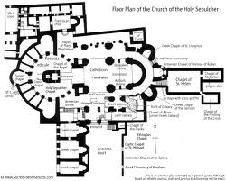
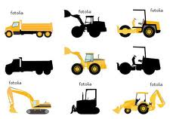


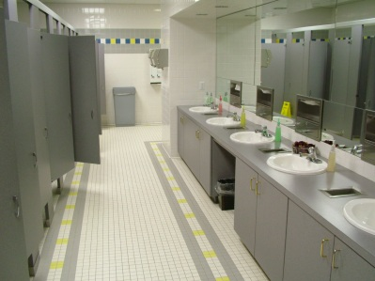
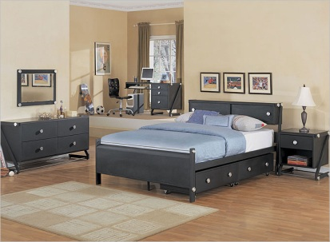
Design and Programming
Software Design
Software Implementation
Development
Python
Lobby 1
Lobby 2
Restroom
Bedroom
Same Role, Similar Design, and Different Interior
Notes:
Previously, we’ve covered why software design is important and how a design and implementation differ from each other.
You can look at it as a blueprint.
This blueprint will be instrumental in the process of constructing.
With a blueprint, however, it is not clear what tools we need to create a building or how we will do the work.
It just a design, the first step in the plans for building this type of house.
In the realm of software, we have to be engaged in development.
During development, an engineer mobilizes various tools and equipment under the guidance of an actual blueprint.
For a more concrete example, let’s consider a lobby and a restroom inside a building.
And there are also other rooms.
If there are two lobbies like this, these places serve a similar role.
Therefore, they are designed similarly.
There are also broad spaces and sofas in these lobbies.
Yet, they can’t be completely identical.
Then, we can change the interior of the building
Although they play a similar role and apply similar designs, what’s actually adopted in realizing the interior would be somewhat different.
Should the architect designer always produce separate blueprints with different features for Lobbies 1 and 2?
He could make a prototype of the lobby with a memo, noting that different interiors are required for Lobbies 1 and 2.
The critical aspects of design are those that must be abided when an existing design is re-used in order to maintain consistency between similar objects that share that design.

Slide 4
Good Software Design
Good or Bad Design?
 | Building Design | Software Design
Correctness | Meet the owner’s purpose Successful construction without faults | Meet the client’s purposes Successful implementation without errors
Robustness | Maintain integrity in a certain level of typhoons | Execute under expected overloads
Flexibility | Enable the future expansions and modifications of the structure | Enable the future updates and expansions of functions
Usability and Reusability | Good support for designed purposes Easy to use for 1) other purposes and 2) other areas | Good support for the designed Easy to use for 1) other purposes and 2) other contexts
Efficiency | Easy to build Cover less area Good mobility in the structure | Easy to implement Smaller size Faster execution
Notes:
What does good software design mean?
In fact, building software is pretty similar to constructing a building.
The most important thing for great software design is its appropriateness.
There is a clear distinction between what’s right and wrong.
What’s wrong basically those fails to meet the goal of a client.
For software to be right, it should satisfy the development objectives of a client.
Even if a design is right, it is still far from good software as long as it produces incorrect outputs or errors.
Hence, software should ensure its correctness to meet a client’s goal without any errors.
The next important factor is robustness.
For instance, some users are always using software and subject it to unexpected stresses.
Even if people do not use the software incorrectly or enter wrong inputs, they can enter excessive input or enter something that was not expected by the programmer.
It’s imperative that a program does not fail.
Thus, a program should respond well to expected incorrect inputs and user habits without errors.
In addition, when you use software over time, you may have to change it.
When a change required, the software should be designed so that you don’t need to disassemble it piece by piece and rebuild it from the beginning.
It should be able to flexibly reflect any possible future modifications.
To support these factors, we’ve got to understand usability and reusability.
For example, it’s necessary for software to fully support the objective of a particular design.
As we cannot force how users deal with software, we have to give them full support.
The interface should be designed to promote intuitive use.
Also, it would be better if this program can be applicable to other purposes
A software may engender thousands of ideas for its applications.
Therefore, it should allow multi-purpose usage.
It should also be designed to be applicable in different environments.
Although a software may satisfy all these conditions, it cannot be good if it takes more than one hour for execution.
In this respect, there are two dimensions of efficiency.
One demands software to be fast and small. The other demands efficiency from a developer’s viewpoint.
The more complex a software design is, the more difficult it is to implement.
Well-designed software should allow a developer to easily comprehend and implement it.
It is simply absurd to remember each of these points, one by one.
I won’t put any questions about all these little details on the test, so don’t worry about it.
However, time and again as your software design practice accumulates, you will naturally recognize what’s important. Now that you’ve taken this lecture, you can review future software design based on what you have learned here.

Slide 5

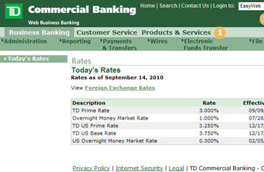

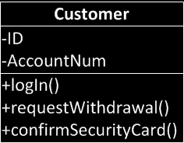
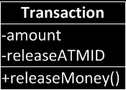
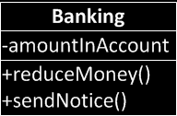
Object-Oriented Design
Real world concepts
Abstract
Abstract
Abstract
Software design entities
Notes:
So far, we’ve covered good design in general.
It does not follow usual design concepts.
It has a universal applicability: that is the ideal.
For example, it serves the purpose for those who apply it, whether the purpose is building naturalism architectures or skyscrapers, and it should be free from errors. It should also be reliable.
Depending on the different situations, how and where the software is stressed would vary. Nevertheless, it should be universally applicable.
Now let’s move on to the topic of design concept.
Design concepts have evolved through diverse paths.
Among the varied design concepts, we will cover objective-oriented design, which has still been being widely used, even though its development dates back to the 1970s and 1980s.
This design is based on the concept that for any program to be good, its design should underpin a real-world concept.
This is the process of turning a real-world concept into the modules of a program.
To demonstrate this, let’s take a banking system and turn it into modules.
There are customers in a bank. They carry out transactions, depositing or withdrawing money.
Also, they use banking accounts to use the functions set up by the banking system.
The users or customers are a concept found in our daily lives.
To modules for a program, we have to determine the name of the concept.
Let’s call it a person with an account, or customer.
Before we move any further, let’s think about the statuses that this real-world concept has. We need to consider its characteristics.
The real world is not static, and things change.
That’s why we need different values for specific moments and situations.
That is a member variable or attribute.
Here, you see three blank spaces.
You can write the name of the concept in the top blank, its characteristics just below, and possible behaviors in the last blank.
The behaviors range from various things including log-in, money withdrawal, and security card check, among other things.
Assigning names is not limited to the subject such as people, but any concept.
Here you see the name, transaction.
And transactions have their own characteristics.
The amount of money, or how much money will be transacted will be classified as characteristics. The ID of an ATM, or which ATM does a particular transaction, can also be defined as a characteristic.
Even abstract concepts have characteristics. This has always held true.
When the last concept is transferred to the real world, a behavior occurs.
“Pay money” is the behavior of a transaction.
Hence, it does not have to be a person to be expressed with names, characteristics, and behaviors. Any abstract concepts can be expressed accordingly through the process of abstraction.
Finally, let’s take a look at the actual banking system.
The banking system also has a name.
It can also contain some information, like how much money is saved in a specific account.
There are various activities such as “lower the amount of money in the account,” “make an announcement,” and more.
Although it shows several characteristics and functions by abstraction, it is obvious that it can define names, characteristics, and behaviors.
This is a process in which real-world concepts can be interpreted into software design entities via object-oriented design. This process is called abstraction.
These entities are names, characteristics, and expected behaviors.
Abstraction permits us to express real world concepts in the form of software design entities.
What is abstraction?
Abstraction is the process of simplification of a complex concept so as to meet the objectives of a design.
It also removes redundant parts and focuses on encapsulating our main interests.

Slide 6
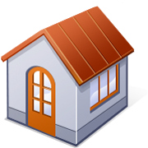

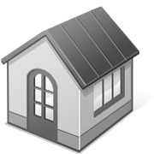
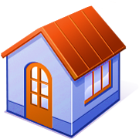



What are Class and Instance?
Class vs. Instance
Class
  Result of design and implementation
  Conceptualization
  Corresponds to design abstractions
Instance
  Result of execution
  Realization
  Corresponds to real world entities
ID: John
Acct #: 123
ID: Park
Acct #: 456
ID: Kim
Acct #: 789
ID: Koh
Acct #: 035
Notes:
As a part of a software design concept, we’ve gone over an object-oriented design.
Using object-oriented design, we’ve abstracted some concepts to translate them into software design entities.
We’ve created a software entity for the people we’re dealing with: the customer. The customer is a single concept, and there are many customers.
Now, how can we express a number of customers as a software entity?
The truth is, we do not express them as a single software entity but with multiple instances.
At this point, let’s recall the concepts of class and instance that we’ve covered in the previous lecture.
A class refers to a single design and its implementations.
It will be something like a blueprint part or software design.
Although there is only one blueprint, we can create several instances by coloring it, relocating it, or making other specific modifications.
When a program is run, it can generate multiple instances.
Prior to the execution of the program, we still may not know many instances would be produced.
This, however, is not the case for a class.
A class is used for designing and implementation.
Thus, we have to operate software to pin down how many instances there are.
In other words, this is called realization.
It is about using an abstract blueprint called class. It constructs several houses, and software modules are applied to generate how many instances are produced.
In the banking example, there are various customers including John, Park, Koh, and Kim. They become separate instances by switching some characteristics here and there.
This is the template or design that is the only thing shared by multiple customers.
When we illustrate customers, what concepts do we express? Conceptualization works the same for all customers.
Put simply, a bank can define individual customers by their ID and account number. Every customer has this information, which is how they are expressed in the software.
Independent, several software instances may carry out the same behavior.
The very action of employing member functions that are designed by a class itself is already involved in the process of creating multiple elements.
Thus, we can produce multiple instances that identically designed by abstraction.
It makes the most out of a single design, expressing and representing the many entities present in the real world.

Slide 7
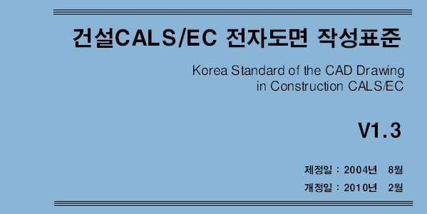
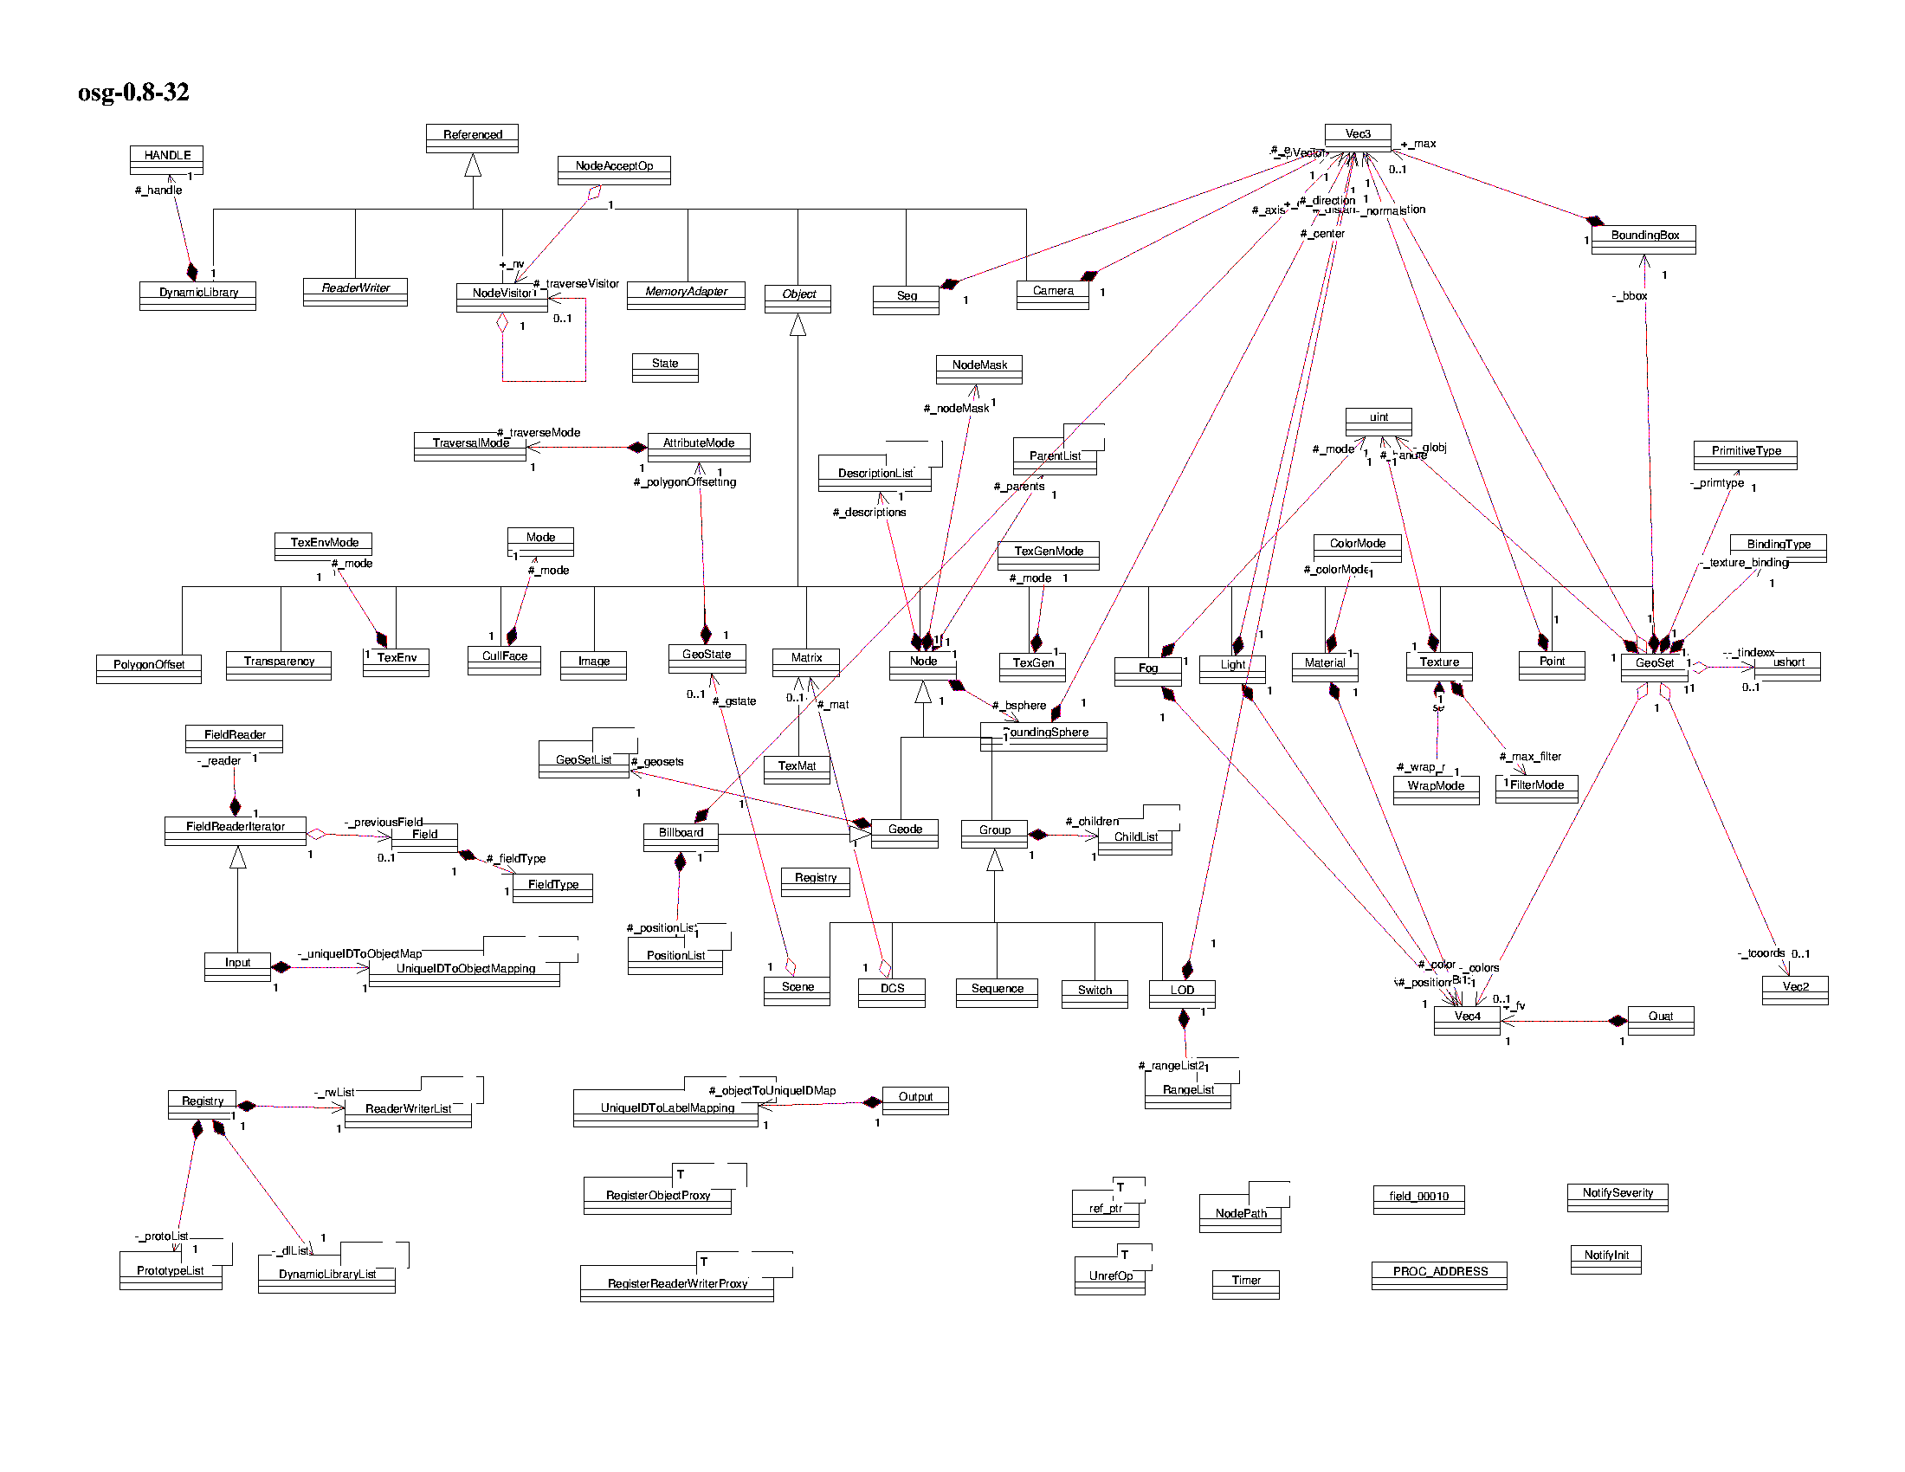

Software Design as House Floorplan
After your graduation, some of you will be constructors of software
  Mainly design
  Some coding
Need to learn how to communicate your colleagues
  Learn standard
  Learn how to represent your design to your boss
In software engineering,
  UML is the standard

Slide 8
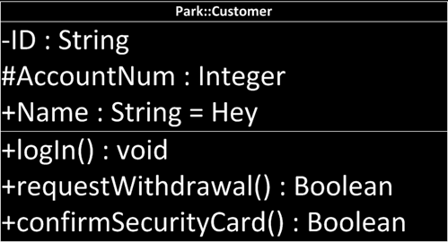
UML notation : Class and Instance
Abstract class
Class
Named instance
Unnamed instance
Person
Customer
Park::Customer
:Customer
Instance Name
Class Name
Member variables
+-#(name):(type)=(default value)
Visibility options
+ → public
# → protected
- → private
Methods
+-#(name)(arguments):(type)

Slide 9
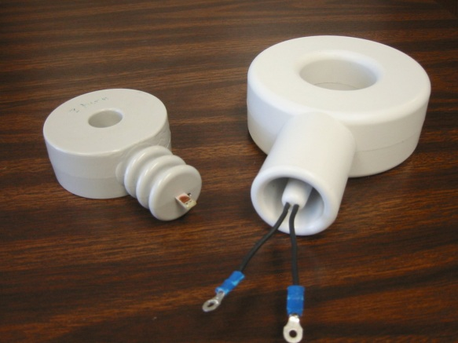
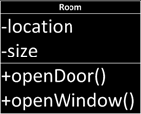


Encapsulation
Object = Data + Behavior
  Data : field, member variable, attribute
  Behavior : method, member function, operation
Delegating the implementation responsibility!
  Bring me a sausage, and I don’t care how you made it
Utilizing the visibility
  private: seen only within the class
  protected: seen only within the class and its descendants
  public: seen everywhere
Python does not support the visibility options!
Building Architecture
I care overall composition
Interior Designer
I care inside implementation
Class Definition
Interface as a specification

Slide 10

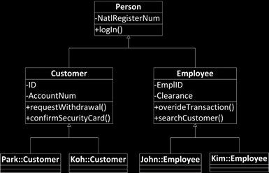
Inheritance
Inheritance
  Giving my attributes to my descendants
    My attributes include
      Member variables
      Methods
  My descendants may have new attributes of their own
  My descendants may mask the received attributes
  But, if not specified, sons follow their father
Superclass
  My ancestors, specifically my father
  Generalized from the conceptual view
Subclass
  My descendants, specifically my son
  Specialized from the conceptual view
How about having a mother?
  Yes. It is possible in Python
Generalized
Specialized

Slide 11
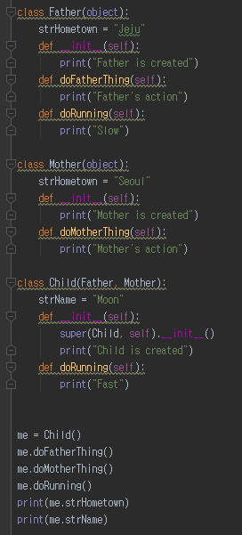
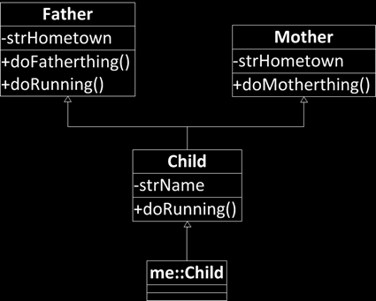
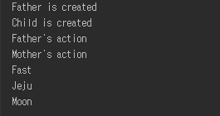
Inheritance in Python
Base Class
(Super Class)
Multiple
Inheritance
See Child has Father’s and Mother’s attributes
See Child overwrite Father’s method by his own

Slide 12
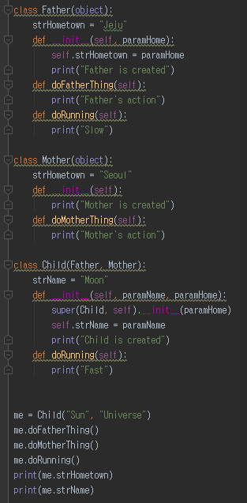
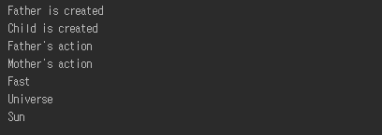
self and super
self : reference variable pointing the instance itself
super : reference variable pointing the base class instance
  super is used to call the base class methods.
Referring Father to point Father’s attributes
Referring itself to point its attributes

Slide 13


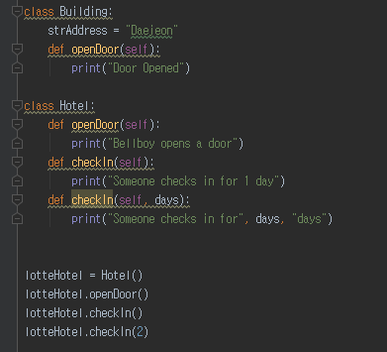
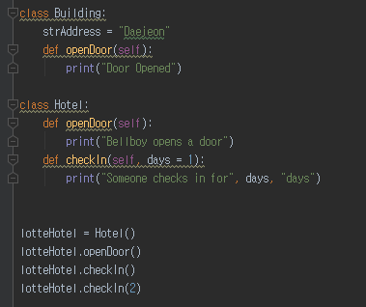

Polymorphism
Light Morph
Black Morph
Polymorphism
  Poly: Many
  Morph: Shape
  Different behaviors with similar signature
    Signature
    = Method name + Parameter list
  Method Overriding
    Base class has a method A(num), and its derived class has a method A(num)
  Method Overloading
    A class has a method A(num), A(num, name), and A(num, name, home)

Slide 14
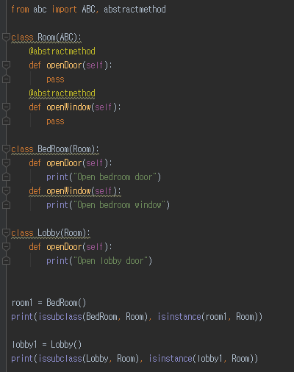
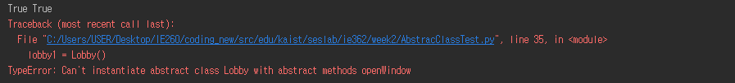
Abstract Class
Abstract class, or Abstract Base Class in Python
  A class with an abstract method
  What is the abstract method?
    Method with signature, but with no implementation
    Why use it then?
    I want to have a window here, but I don’t know how it will look like, but you should have a window here!
  Abstract class is not a complete implementation, it is more like a half-made produce
  Therefore, you can’t make an instance out of it
The concrete class with full implementations and inheriting the abstract class will be a basis for instances
Indicator of abstract base method and class

Slide 15
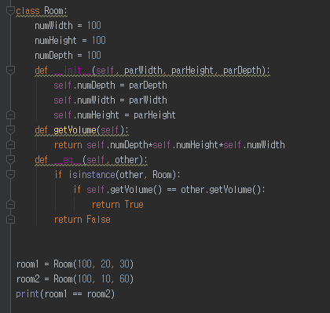
Overriding Methods in object
All of Python classes are the descendants of object
  If you don’t specify the base class of your class, then your class is the direct derived class of object
object has many hidden methods
  _ _ init _ _
  _ _ del _ _
  _ _ eq _ _
  _ _ cmp _ _
  _ _ add _ _
You override them to make the methods behave as you please
Duck Typing
Easier to Ask for Forgiveness then Permission (EAFP)

Slide 16
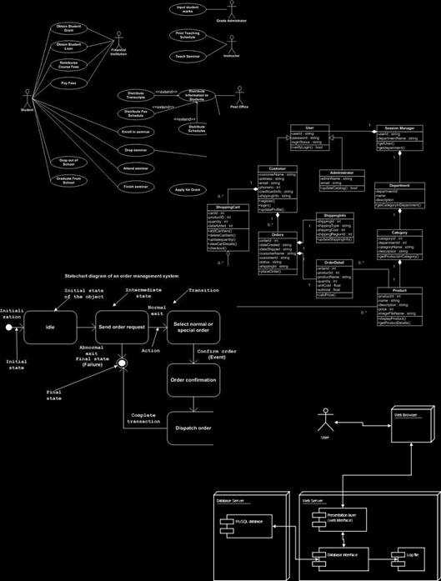
More about UML Notations
Many types of UML diagrams used for different stages of development. If I name a few of them…
  Use-case diagram
  Class diagram
  State diagram
  Deployment diagram
We are dealing with OOP in this week
  Mainly, class and instances
  Also, some of software design patterns
  Hence, we focus on
    Class diagram

Slide 17

UML notation : Class and Instance (one more time)
Abstract class
Class
Named instance
Unnamed instance
Person
Customer
Park::Customer
:Customer
Instance Name
Class Name
Member variables
+-#(name):(type)=(default value)
Visibility options
+ → public
# → protected
- → private
Methods
+-#(name)(arguments):(type)

Slide 18
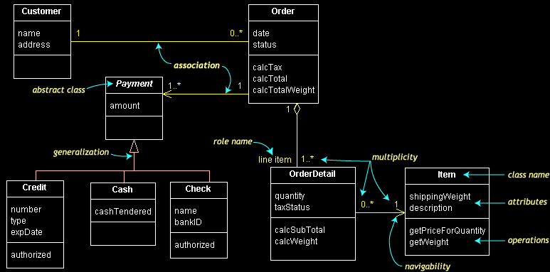
Structure of Classes in Class Diagram
What makes a structure?
Entity and Relationship
Entity
Relationship and its characteristic

Slide 19
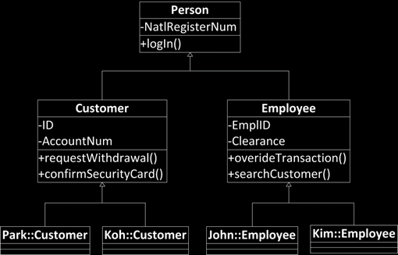
Generalization
Generalization between classes
  is-a relationship
  Inheritance relationship
  Customer → Person
    From subclass
    To superclass
    Direction of generalization
  Hollow triangle shape
Base class
  Person
Leaf class
  Park::Customer…

Slide 20
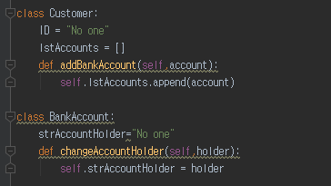
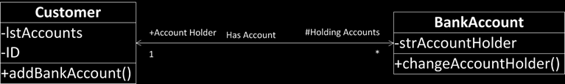
Association
Association between classes
  has-a relationship
  Member variables
    A customer has a number of holding accounts
    An account has an account holder customer
  Simple line
  If a simple arrow is added
    A customer has a reference to bank accounts
    A bank account has a reference to a customer
    Navigability
  Line ends are tagged by roles
    Account holder
    Holding accounts
    With prefix showing the visibility
      +: public , -: private, #: protected
Roles
Navigability
Name
Multiplicity

Slide 21
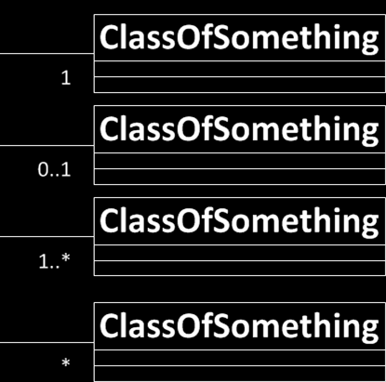
Multiplicity of Association
In computer science and engineering
  * often means many
  Hence,
    1..*
      1 to Many
    *
      0 to Many
  Naturally
    1
      Exactly one
    0..1
      One or zero
If not specified, it means one

Slide 22

Aggregation
Special case of association
  Special has-a relationship
  More like, part-whole or part-of relationship
  A family member is a part of a family
    The existence of the family depends on the aggregation of the family member
    If nothing to aggregate, there is no family
  Hollow diamond shape
Aggregation often occur
  when an aggregating class is a collection class
  When the collection class’s life cycle depends on the collected classes

Slide 23
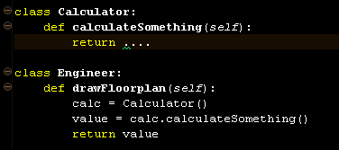

Dependency
Dependency between classes
  use relationship
  An engineer uses a calculator
    May use for
      Local variables
      Method signatures
        Parameter types
      Method return types
  Something that you import for the implementation

Slide 24
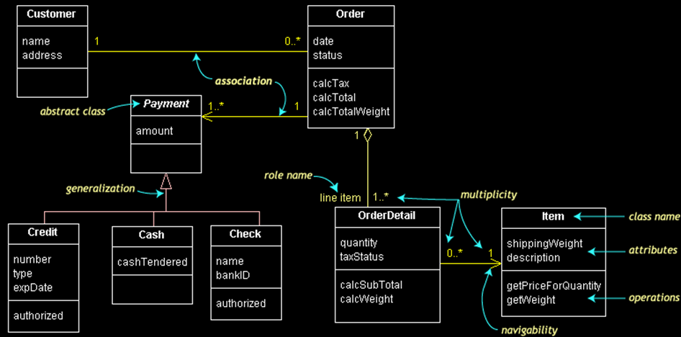
Let’s Practice

